Slide 1

Logistics Megatrends
Dr. Dale S. Rogers
Nevada Logistics Institute
Reno, NV
22 July 2019

Slide 2
Introduction

Slide 5
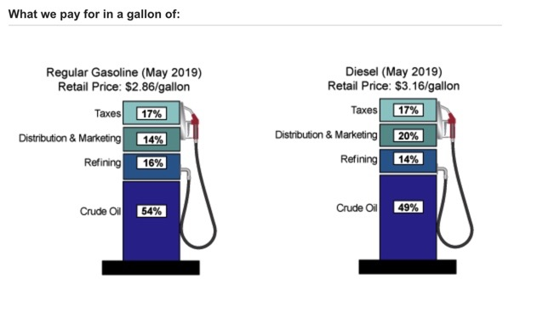

Slide 6
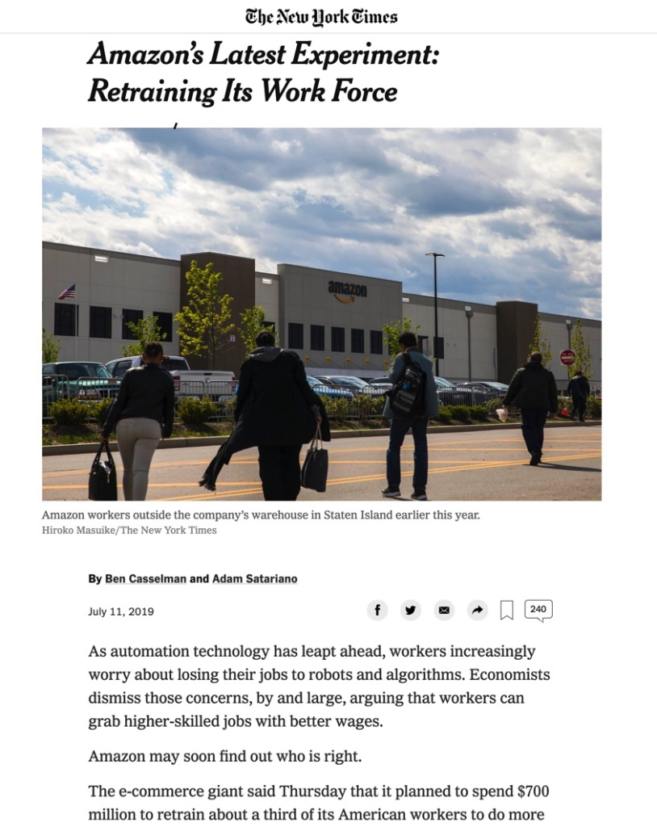

Slide 7
Forces

Slide 8
Historical Milestones In Conceptualization
Shifts in Logistical Thinking
• Transportation Efficiency 3000_{BC}
• Total Cost Awareness 1950_{AD}
• Customer Service 1955
• Comprehensive Outsourcing 1965
• Operational Integration and Quality (Six Sigma) 1975
• Financial Positioning and Operational Excellence 1985
• Globalization 1990
• Customer Relationships and Enterprise Extension 1995
• Supply Chain Integrative Management 2000
• Responsive Supply Chain Management 2005+
Source: Dr. Donald J. Bowersox, FedEx Summit, February 2008, February 2008

Slide 11
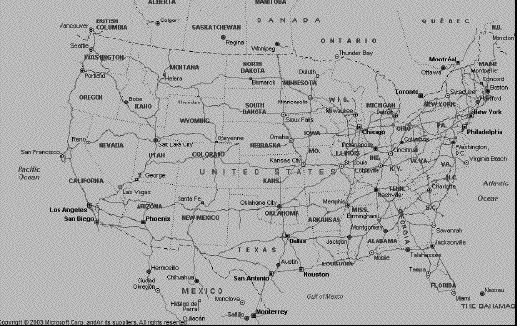
U.S. Logistics Flows

Slide 12
U.S. Rail System Map

Slide 13
U.S. Rail System Map

Slide 14
2019 Top 50 World Container Ports
Rank Port
1 Shanghai, China
2 SIngapore
3 Shenzhen, China
4 Ningbo-Zhoushan, China
5 Hong Kong, S.A.R., China
6 Busan, South Korea
7 Qingdao, China
8 Guangzhou Harbor, China
9 Jebel Ali, Dubai, United Arab Emirates
10 Tianjin, China
11 Rotterdam, Netherlands
12 Port Klang, Malaysia
13 Kaohsiung, Taiwan, China
14 Antwerp, Belgium
15 Dalian, China
16 Xiamen, China
17 Tanjung Pelepas, Malaysia
18 Hamburg, Germany
19 Los Angeles, U.S.A.
20* Keihin Ports, Japan
21 Long Beach, U.S.A.
22 Laem Chabang, Thailand
23 New York-New Jersey, U.S.A.
24 Yingkou, China
25 Bremen/Bremerhaven, Germany
Rank Port
26 Ho Chi Minh, Vietnam
27 Tanjung Priok, Jakarta, Indonesia
28 Columbo, Sri Lanka
29 Suzhou, China
30 Lianyungun, China
31** Hanshin Ports, Japan
32 Valencia, Spain
33 Algerciras Bay, Spain
34 Jawaharlal Nehru, India
35 Manila, Philippines
36 Jeddah, Suadi Arabia
37 Felixstowe, U.K.
38 Haiphong, Vietnam
39 Santos, Brazil
40 Georgia Ports, U.S.A.
41 Port Said East, Egypt
42 Colon, Panama
43*** Seattle-Tacoma NW Seaport Alliance, U.S.A.
44 Sharjah, United Arab Emirates
45 Piraeus, Greece
46 Balboa, Panama
47 Tanjung Perak, Surabaya, Indonesia
48 Ambarli, Turkey
49 Marsaxlokk, Malta
50 Vancouver, Canada

Slide 15
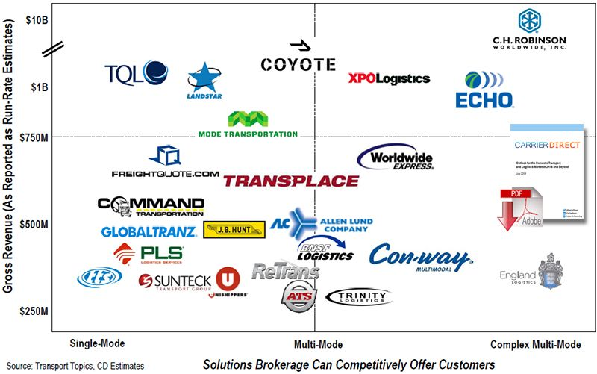
Transportation Brokers

Slide 16
Hours of Service

Slide 17
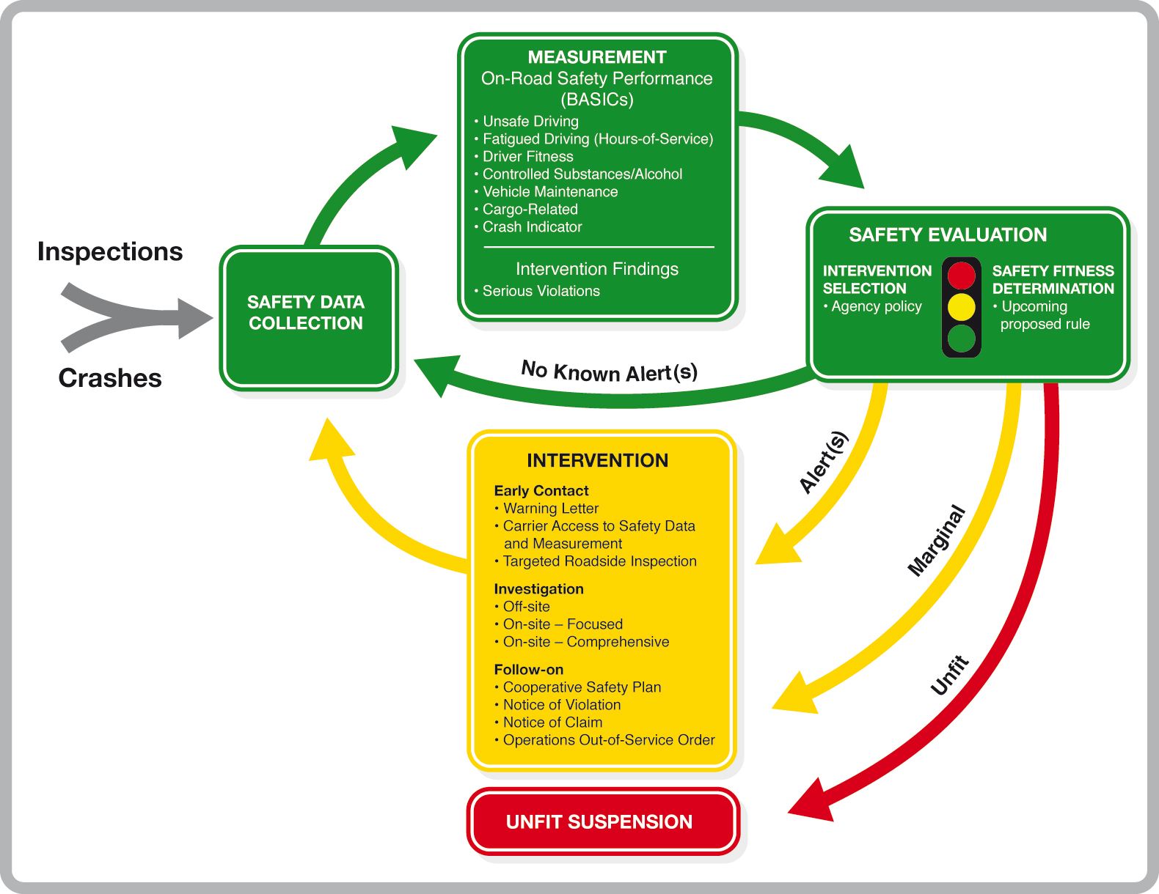
CSA

Slide 18
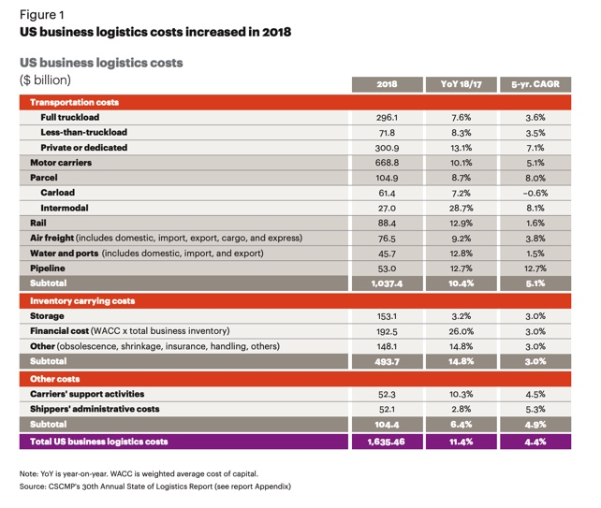
2018 U.S. Logistics Costs

Slide 20
Setting the Stage
2008 – 2009 Recession has given way to a “new normal” of:
Low growth
Rising Income inequality
Political Dysfunction
Social tension

Slide 21
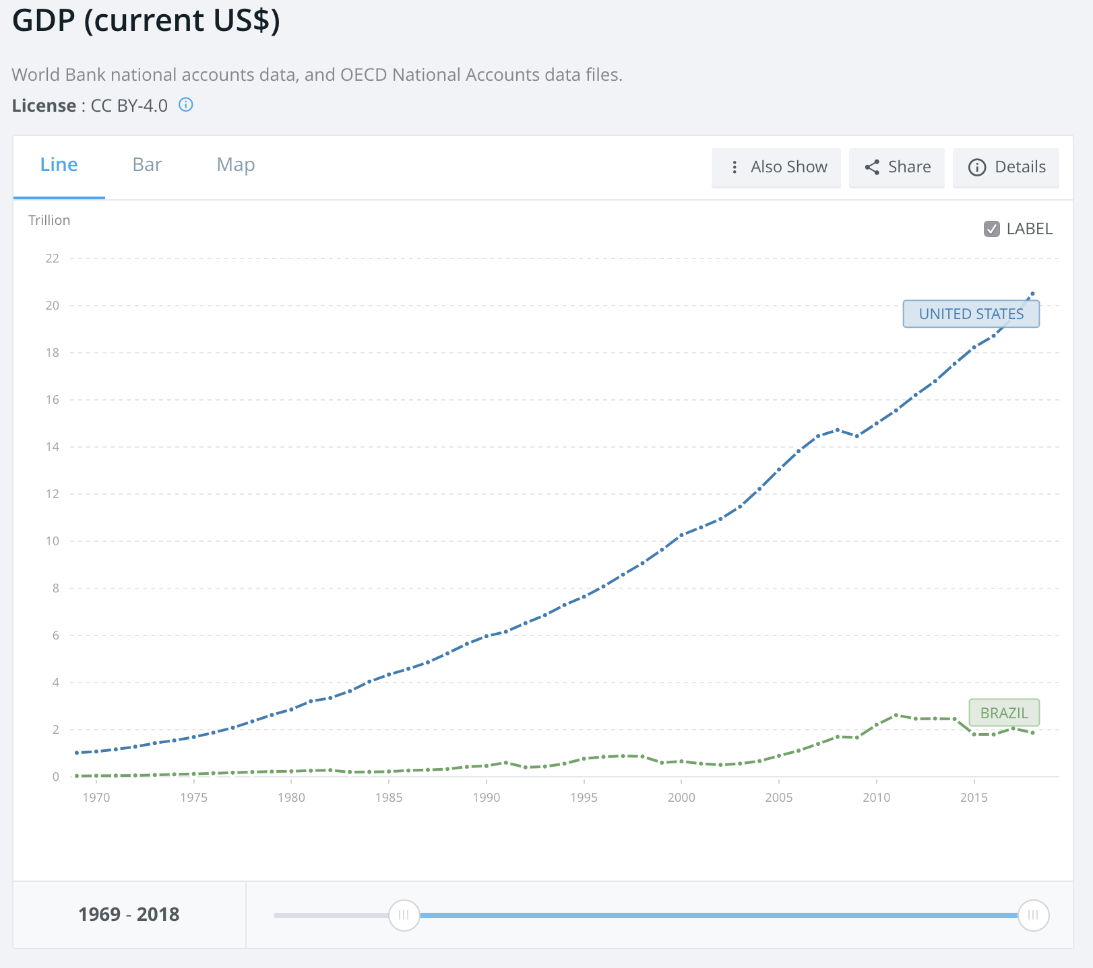
U.S vs Brazilian GDP 1969-2018

Slide 23
Increased Stability – Great Moderation
Shift in employment to less cyclical, service-based industries. Inventory and dura le goods production tend to be destabilizing.
Increased size of acyclical government sector.
Increased role of automatic (mainly fiscal) stabilizers
Reduced frequency and intensity of fiscal crises.
Some favorable fiscal (mainly tax) policies
Reduced volatility of monetary growth
Greater confidence in private economic agents, both induced by business cycle moderation itself and inducing behavior favorable to more stable economic growth.
Source: Zarnowitz, Victor (1992). Business Cycles. University of Chicago Press.

Slide 24
GDP
However, GDP is only a measure of finished goods and services in the last tier before the consumer.
GDP first came into use in 1937 in a report to the US Congress in response to the Great Depression after Russian economist Simon Kuznets conceived the system of measurement.
GDP is Keynesian
Purchasing managers intuitively understand problems with GDP.
Dr. John Hoagland

Slide 25
Purchasing Managers Index 1948 - 2017

Slide 26
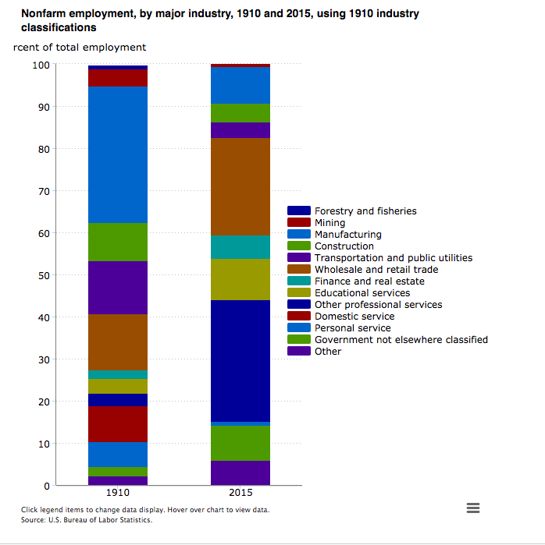

Slide 27
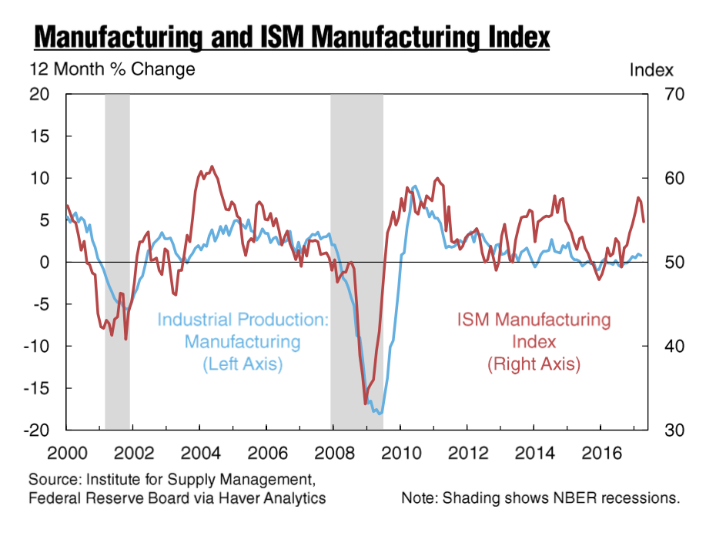

Slide 28
ISM Most Recent Results
MANUFACTURING AT A GLANCE April 2017
Index | Series Index Apr | Series Index Mar | Percentage Point Change | Direction | Rate of Change | Trend* (Months)
PMI® | 54.8 | 57.2 | -2.4 | Growing | Slower | 8
New Orders | 57.5 | 64.5 | -7.0 | Growing | Slower | 8
Production | 58.6 | 57.6 | +1.0 | Growing | Faster | 8
Employment | 52.0 | 58.9 | -6.9 | Growing | Slower | 7
Supplier Deliveries | 55.1 | 55.9 | -0.8 | Slowing | Slower | 12
Inventories | 51.0 | 49.0 | +2.0 | Growing | From Contracting | 1
Customers' Inventories | 45.5 | 47.0 | -1.5 | Too Low | Faster | 7
Prices | 68.5 | 70.5 | -2.0 | Increasing | Slower | 14
Backlog of Orders | 57.0 | 57.5 | -0.5 | Growing | Slower | 3
New Export Orders | 59.5 | 59.0 | +0.5 | Growing | Faster | 14
Imports | 55.5 | 53.5 | +2.0 | Growing | Faster | 3
OVERALL ECONOMY |  |  |  | Growing | Slower | 95
Manufacturing Sector |  |  |  | Growing | Slower | 8

Slide 29
Logistics Managers Index

Slide 30
Logistics Managers Index

Slide 31
End of presentation
Extra slides follow

Slide 32
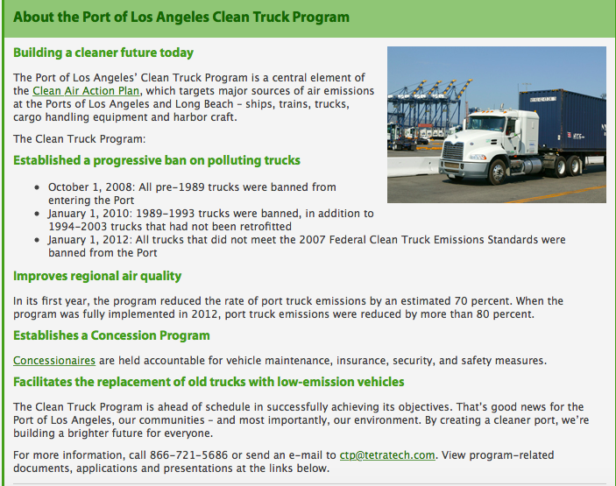

Slide 33
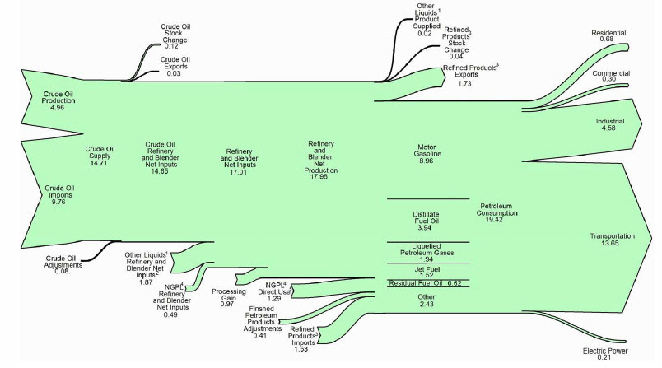
2009 U.S. Petroleum Usage

Slide 34
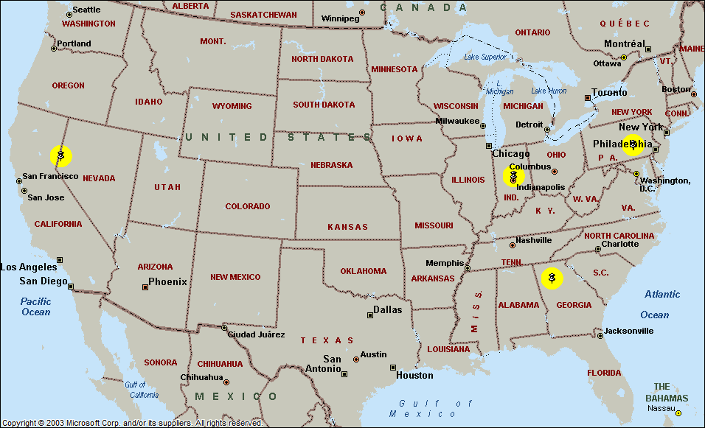
Impact of Large Fuel Cost Increase on Logistics Infrastructure

Slide 35
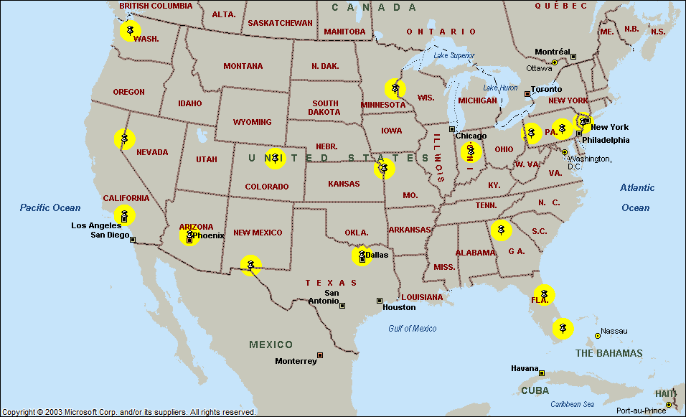
Impact of Large Fuel Cost Increase on Logistics Infrastructure

Slide 36
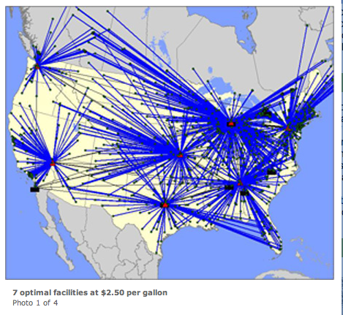
7 Facilities - $2.50 per Gallon

Slide 37
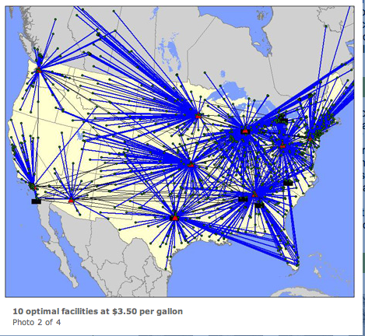
10 Facilities - $3.50 per Gallon

Slide 38
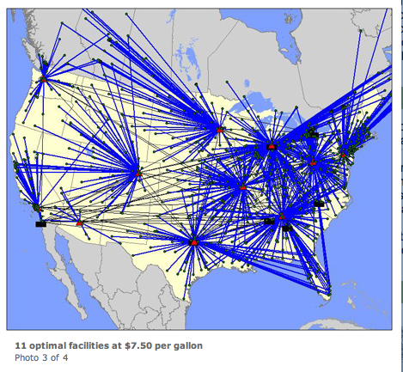
11 Facilities - $7.50 per Gallon

Slide 39
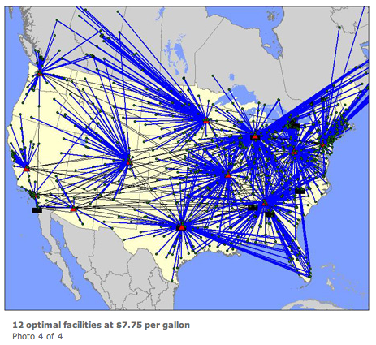
12 Facilities - $7.75 per Gallon

Slide 40
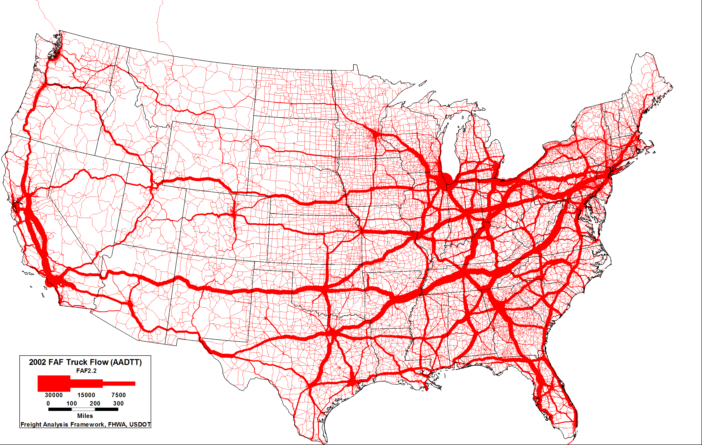
2002 Annual Average Daily Truck Traffic
Notes:
National perspective – regional and national corridors
2002 FAF truck flow – annual average daily FAF truck traffic - AADFTT

Slide 41

2035 Annual Average Daily Truck Traffic
Notes:
National perspective – regional and national corridors
Projected 2035 FAF truck flow – annual average daily FAF truck traffic - AADFTT
Scale of line thickness is the same as the 2002 map (they are comparable)

Slide 42
Work Patterns

Slide 43



